Slide 1

PROTECTED EXCEPTION BASED EXECUTION SYSTEM
CSA1220-COMPUTER ARCHITECTURE FOR FUTURE ENGINEERS
Guided by PRESENTED BY
DR.T.KUMARAGURUBARAN S.THANIGAIVEL(192565006)
DR.S.SENTHILVADIVU S.UDHAYAKUMAR(192565001)
C.MARIA KEVIN JOE(192511252)

Slide 2
Introduction to Exceptions
Exceptions are problems that happen when a program runs
Common causes: divide by zero, file not found, wrong input
If not handled, the program can crash
Exception handling helps control and fix these problems
It keeps programs safe and reliable

Slide 3
Types of Exceptions
Software exceptions – caused by coding errors
Hardware exceptions – caused by physical system problems
Synchronous – happen during a specific task
Asynchronous – can happen anytime
Checked/Unchecked – some must be handled, others optional

Slide 4
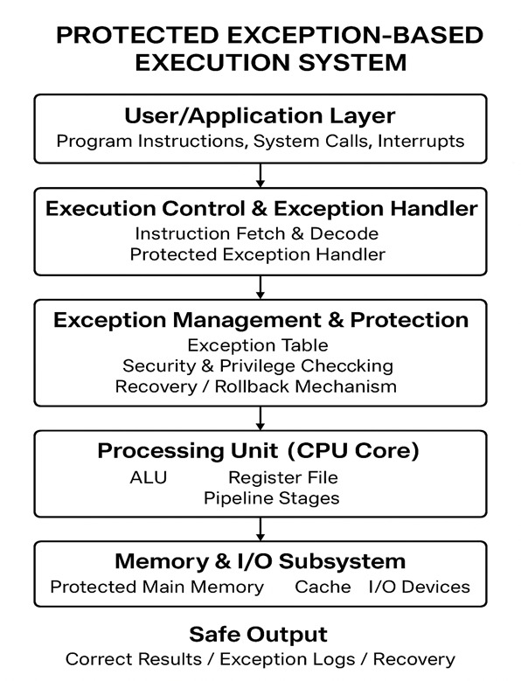
Protected Execution
Keeps each program running in its own safe area
Stops one program from changing another’s data
Uses hardware features like memory protection
Protects the system from crashes and bugs
Important for security and stability

Slide 5
Exception Handling Process
Uses try, catch, and finally in code
When a problem happens, the program jumps to catch
The program can fix the problem or shut down safely
Stack unwinding helps return to a safe point
Logs are created to help find the problem later

Slide 6

Code: Output:
def safe_divide(a, b):
try:
result = a / b
print("Result:", result)
except ZeroDivisionError:
print("Error: You can't divide by zero.")
except Exception as e:
print("An unexpected error occurred:", e)
# Test cases
safe_divide(10, 2) # This will work
safe_divide(5, 0) # This will raise a ZeroDivisionError

Slide 7
Security and Real-World Use
Stops hackers from using errors to break into systems
Keeps important data safe during errors
Used in cars, planes, hospitals, and banks
Helps systems recover from small problems
Makes devices like phones and TVs more reliable

Slide 8
Conclusion
Exceptions are unexpected problems in programs
Protected exception systems help fix or avoid crashes
They keep systems safe, fast, and working well
Used in many real-life areas where safety matters
They are key to building smart, secure technology

Slide 9
THANK YOU

